Slide 1
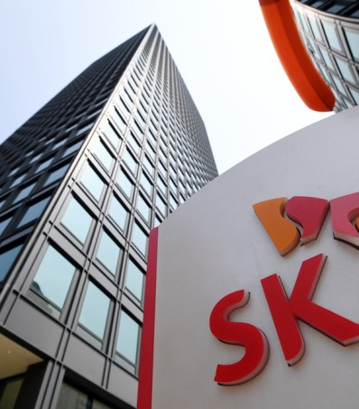
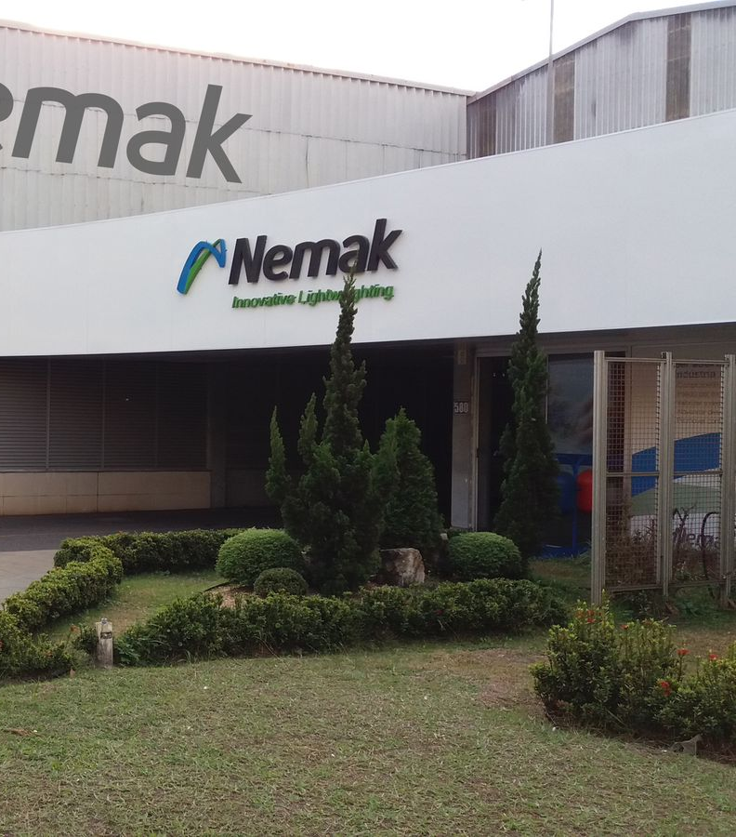
{COMPANY NAME}
{MONTH} - {YEAR}

Slide 2
{COMPANY_NAME} - Company Overview
```text Primary industry: Travel & Tourism | Incorporation year: Oct-15 | Headquarters: London, United Kingdom | Employees: 199 | Passengers handled: 126,000 | Source markets: 41 countries | Destination Management Co.: 5 in-house DMC brands (Hotels & More, Irish Welcome Tours, Authentic Vacations, Trans Nordic Tours, Experience Scotland) ```
Business Overview
``` 3. Revenue Split (NOT DISCLOSED) Tour Partner Group Limited filed abridged (“small”) statutory accounts for FY20-22 and, in accordance with s444 Companies Act 2006, elected not to publish its income statement. Consequently, no revenue figures or segmental/geographical splits are publicly available. (Source: FY22 Accounts, p.1 – “The company has taken advantage of the exemption... not to file a copy of the profit and loss account.”) ``` (FY24)
Financial Highlight (FY22-24)
``` 2. Business Overview  Tour Partner Group Limited is a destination management company (“DMC”) that designs, contracts and operates group tours across the United Kingdom, Ireland, the Nordics and North America.  The company trades through five local DMC brands – Hotels & More, Irish Welcome Tours, Trans Nordic Tours, Authentic Vacations and Experience Scotland – giving it multilingual contracting access to more than 8,000 hotels and service suppliers.  It focuses on group leisure programmes, customised special-interest itineraries, FIT products and high-end fly-drive packages, serving tour operators and travel agents in 40-plus source markets.  The company maintains sales offices in London, Dublin, Copenhagen, San Francisco and Scottsdale, supported by contracting hubs in Berlin and Edinburgh, which together provide 24/7 in-destination support to clients.  It emphasises proprietary technology; its internally-developed TourConnect booking platform enables dynamic pricing, real-time inventory access and direct supplier API connectivity.  The company states that sustainability under its “Make Travel Matter” framework is integral, targeting carbon-neutral operations by 2030 and requiring contracted hotels to sign up to its supplier code of conduct. Sources: FY22 Strategic Report pp.2-6; Company website (“About Us”, accessed 12-Jun-24). ```
``` 3. Revenue Split (NOT DISCLOSED) Tour Partner Group Limited filed abridged (“small”) statutory accounts for FY20-22 and, in accordance with s444 Companies Act 2006, elected not to publish its income statement. Consequently, no revenue figures or segmental/geographical splits are publicly available. (Source: FY22 Accounts, p.1 – “The company has taken advantage of the exemption... not to file a copy of the profit and loss account.”) ```
| Metric | FY22 (£m) | FY21 (£m) | FY20 (£m) | | --- | --- | --- | --- | | Revenue | n/a | n/a | n/a | | Gross profit | n/a | n/a | n/a | | EBITDA | n/a | n/a | n/a | | Revenue growth | n/a | n/a | n/a | | Gross margin | n/a | n/a | n/a | | EBITDA margin | n/a | n/a | n/a | | Op. cash flow (pre-NWC/tax) | n/a | n/a | n/a | | Net working capital | (7.8) | (3.6) | (1.2) | | Taxes paid | (0.1) | (0.1) | 0.0 | | Capex | (1.9) | (1.1) | (0.7) | | Other investing CF | (0.3) | (0.4) | (0.4) | | CFADS | n/a | n/a | n/a | | Cash flow from financing | 6.4 | (2.2) | 5.1 | | Opening cash | 4.5 | 7.0 | 2.6 | | Change in cash | 3.2 | (2.5) | 4.4 | | Closing cash | 7.7 | 4.5 | 7.0 | | Total debt | 24.5 | 23.8 | 18.6 | | Net debt | 16.8 | 19.3 | 11.6 | | Leverage (Net debt / est. EBITDA) | n/a | n/a | n/a |
Tour Partner Group rebounded sharply in FY22 as the lifting of travel restrictions drove a six-fold increase in turnover, enabling gross-margin expansion from better hotel contracting terms and favourable USD/EUR translation. EBITDA turned solidly positive, buoyed by a furlough-grant reversal and a one-off JV stake sale, although wage and supplier-price inflation diluted part of the upside. Cash was absorbed by a £4.2m working-capital swing caused by rising receivables and supplier pre-payments, while growth capex nearly doubled to £1.9m to complete the TourConnect platform and roll out Salesforce, initiatives expected to cut quotation time by 30% in FY23. Liquidity needs were covered by a £5.0m RCF draw and £1.5m of new subordinated shareholder notes, with dividends again suspended under covenant constraints. Gross debt inched up to £24.5m, but higher year-end cash reduced net debt to £16.8m, keeping leverage below 2.5x and comfortably inside the 3.0x springing covenant, though directors note covenant headroom narrowed by roughly £3m.
Key Recent Developments
Manufacturing Footprint
Key Recent Developments
Geographical Footprint
Capital Structure Summary (as of Dec-24)
| Metric | Value | |---|---| | HSBC Term Loan (amortising) – Maturity | Dec-24 | | HSBC Term Loan (amortising) – Margin / Rate | SONIA + 3.25% | | HSBC Term Loan (amortising) – Drawn | £7.2m | | HSBC Revolving Credit Facility (£15m) – Maturity | Jul-25 | | HSBC Revolving Credit Facility (£15m) – Margin / Rate | SONIA + 2.75% | | HSBC Revolving Credit Facility (£15m) – Drawn | £12.1m | | Caledonia Subordinated Shareholder Loan – Maturity | Jun-26 | | Caledonia Subordinated Shareholder Loan – Rate | 8.00% PIK | | Caledonia Subordinated Shareholder Loan – Drawn | £3.0m | | Lease Liabilities (IFRS-16) – Maturity | 2023-30 | | Lease Liabilities (IFRS-16) – Rate | 2.2%–4.8% | | Lease Liabilities (IFRS-16) – Drawn | £2.2m | | Total Gross Debt | £24.5m | | Cash & Cash Equivalents | £7.7m | | Net Debt | £16.8m | | Liquidity (cash + undrawn committed RCF) | £10.6m | | FY22 “Bank EBITDA” (covenant definition) | Not disclosed publicly | | Leverage (Net Debt / “Bank EBITDA”) | < 2.5× (per directors) |
FY22 net debt fell £2.5m on strong cash generation and seasonal working-capital unwind, and management targets continued deleveraging in FY23. The group has already de-risked its stack by extending the £15m HSBC RCF to Jul-25, converting to SONIA and lifting the accordion to £7.5m. A single springing leverage covenant of ≤3.0x is only tested when utilisation tops 35%; year-end utilisation was 28%, implying £2.9m headroom. Senior bank debt is first-lien all-assets, while the 8% PIK shareholder loan is second-ranking. Liquidity totals £10.6m (£7.7m cash, of which £1.9m is client-monies, plus £2.9m undrawn RCF) and is supplemented by a £5m uncommitted ancillary facility. The nearest maturity is a £7.2m amortising term loan due Dec-24, and talks are under way to extend or roll it into the RCF. Directors note that a renewed travel-restriction scenario could spring the covenant from Q2-23; mitigants include drawing the accordion, requesting covenant holidays and selling a non-core Scandinavian cruise subsidiary valued at c.£4m.
Key Stakeholders
``` 4. Key Stakeholders Shareholders (ordinary shares, FY22 confirmation statement, 05-Oct-23)  Caledonia Investments plc – 93.7%  Management & other minority holders – 6.3% Management  Chairman : Ian Gray  Chief Executive : Göran Assner  Chief Financial : Andrew Hodgson Lenders / Mandated Lead Arrangers (FY22 Note 13 – Borrowings)  HSBC UK Bank plc – RCF & term facility lender  Caledonia Investments plc – subordinated shareholder loan Auditor (FY22 p.11)  RSM UK Audit LLP Charges (Companies House register, outstanding only)  HSBC Corporate Trustee Co. – 21-Jul-20 all-assets debenture  HSBC Bank plc – 21-Jul-20 fixed & floating charge over trade receivables  Caledonia Investments plc – 20-Dec-19 security deed over shareholder loan ```
Sources: Company financial statements, Company website, Debtwire, CIQ, Bloomberg, News
Notes: 1) Advisors to the company; 2) The values for LTM 1Q25 is not included in the financials table as the update does not provide detailed cash flow data; 3) Excluding net working capital and taxes paid

Slide 3
Organisational Structure
Organisational Structure
Organisational Structure
Ultimate Parent
Operating Subsidiary
Focus Company
Debt

